Slide 1
Efficient Reasoning in Large Language Models
- A Structured Survey
Presented by Chandini Saisri Uppuganti (018228483)
Based on article : https://arxiv.org/abs/2503.16419

Slide 2
Motivation
LLMs are reasoning well but inefficient.
Challenge: Reduce unnecessary steps without sacrificing accuracy.
Applications: Healthcare, autonomous systems, embodied AI.

Slide 3
Overview of Reasoning in LLMs
LLMs use Chain-of-Thought (CoT) prompting for step-by-step logic.
Improves accuracy in math, coding, and reasoning tasks.
Drawback: verbose outputs increase latency and cost.
Need: Make reasoning concise, without losing correctness.

Slide 4
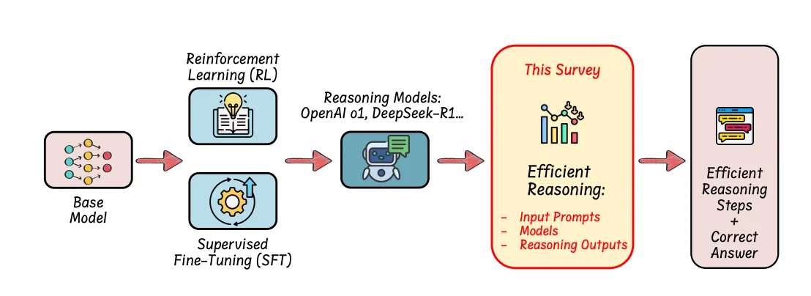
Efficiency Pipeline Overview
Fig: From base model to efficient reasoning via RL, SFT, and survey strategies

Slide 5
The Three Pillars of Efficient Reasoning
Model-Based Efficiency
Output-Based Efficiency
Prompt-Based Efficiency

Slide 6
Model-Based Efficiency
Reinforcement Learning with Length-Aware Rewards
Supervised Fine-Tuning (SFT)
Model Merging and Progressive Fine-Tuning

Slide 7
Output-Based Efficiency
Latent Reasoning Representations
Auxiliary Modules (e.g., SoftCoT
Dynamic Inference Strategies
Best-of-N sampling, Beam Search, MCTS
Certainty-driven early stopping
Summarization-based CoT (e.g., LightThinker, InftyThink)

Slide 8
Prompt-Based Efficiency
Concise Reasoning Prompts
Prompt-Based Routing
No model modification required.

Slide 9
Chain-of-Thought & Emerging Reasoning Models
Chain-of-Thought (CoT) Prompting
CoT Variants - CoT, ToT, GoT
From Prompting to Built-In Reasoning
    OpenAI o1: Monte Carlo Tree Search + reward modeling.
    DeepSeek-R1: SFT + rule-based RL for logic-centric tasks.

Slide 10
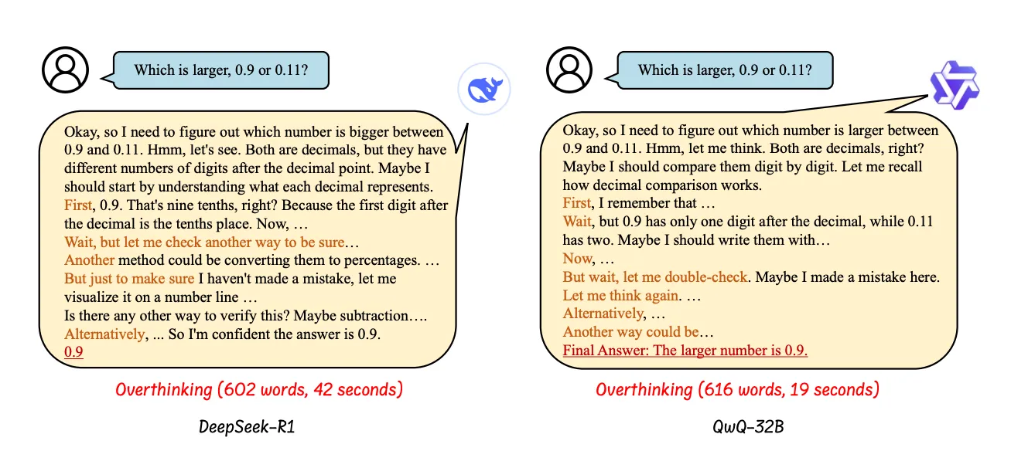
Fig: An example of the “overthinking phenomenon”

Slide 11
Model-Based Efficient Reasoning
Reinforcement Learning (RL) with Length-Aware Rewards
Supervised Fine-Tuning (SFT) with Variable-Length CoT
      Post-Reasoning Compression: Trimming after generation (C3oT, TokenSkip).
      During-Reasoning Compression: Prompt-driven brevity (BoN Sampling, CoT-Valve, Token-Budget).

Slide 12
Fine-Tuning Strategies for Efficient Reasoning
Standard Fine-Tuning
Progressive Fine-Tuning
Model Merging

Slide 13
Output-Based Efficient Reasoning
Latent Reasoning Representations
Auxiliary Modules (e.g., SoftCoT)
Dynamic Inference Optimization

Slide 14
Prompt-Based Efficient Reasoning
Smarter Inputs, Not Heavier Models
  Prompt-Guided Reasoning
  Attribute-Driven Routing

Slide 15
Efficient Training & Compression for Reasoning
Reasoning with Less Data
Small Model Optimization
    Distillation
    Compression

Slide 16
Evaluation & Benchmarks
Sys2Bench, Bag of Tricks, S1-Bench
Overthinking Metrics
Impact of Compression

Slide 17
Real-World Applications
Autonomous Driving
Embodied AI
Healthcare
Recommender Systems

Slide 18
References
https://arxiv.org/abs/2503.16419

Slide 19
Thank you!!!

